Slide 2
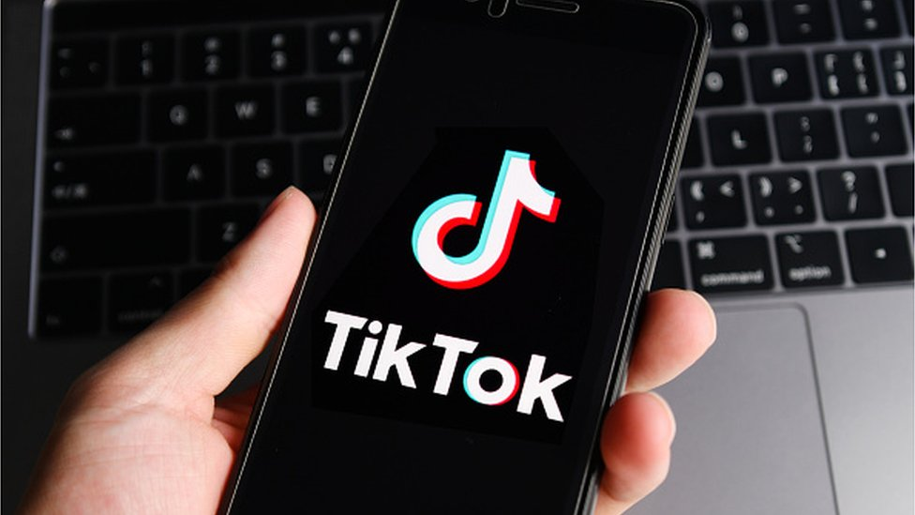

Slide 3


Table Of Content
01
Why TikTok is So Popular
02
The Rise of TikTok
03
Pros and Cons
04
Conclusion

